Slide 1
Multiple pregnancy
Prof. Tiran Dias
Professor in Fetal Medicine
Faculty of Medicine
University of Kelaniya

Slide 2
Learning Objectives
List the risk factors for multiple pregnancy
Describe embryology of multiple pregnancy
Describe the unique maternal physiologic changes associated with multiple pregnancy
Describe the diagnosis and management of multiple pregnancy
Describe the potential maternal and fetal complications associated with multiple pregnancy

Slide 3
Risk factors for multiple pregnancy
The presence of more than one fetus in the gravid uterus is called multiple pregnancy
Two fetuses (twins)
Three fetuses (triplets)
Four fetuses (quadruplets)
Five fetuses (quintuplets)
Multiple pregnancy represents 2 to 3% of all pregnancies

Slide 4
Risk factors for multiple pregnancy
Race: most common in Black Africans
Age: Increased maternal age
Parity: more common in multipara
Heredity - family history of multifetal gestation
Nutritional status – well nourished women
ART - ovulation induction with clomiphene citrate, gonadotrophins and IVF

Slide 5
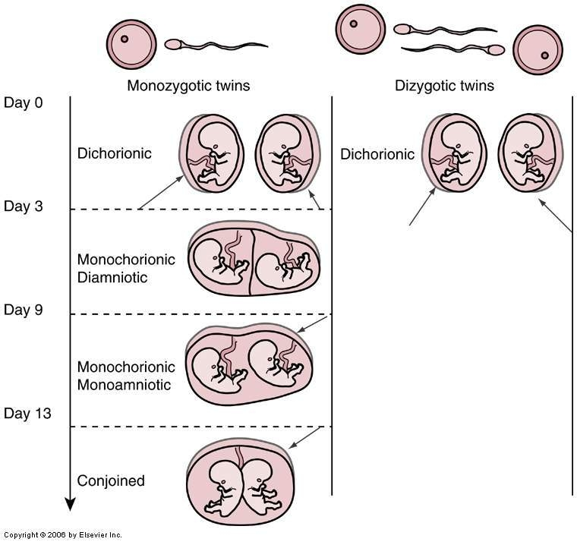
Embryology of multiple pregnancy
Two-third)
One-third)

Slide 6
Differences in zygocity
Monozygotic
Dizygotic
1 ova + 1 sperm
Same sex
Identical features
Single or double placenta
Same genetic features
DNA microprobe -same
2 ova + 2 sperm
Same or opposite sex
Fraternal resemblance
Double or s/t fused
Different genetic features
DNA microprobe - different

Slide 7
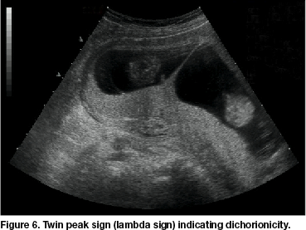
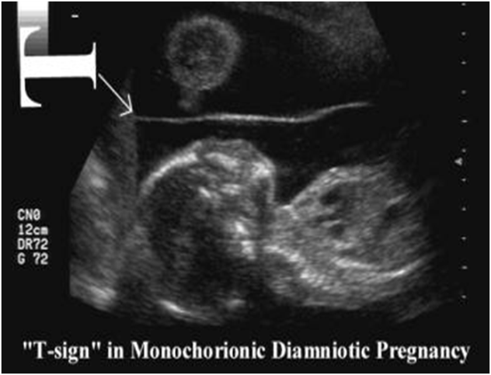
Differences in chorionicity with single placenta
Dichorionic
Monochorionic
Monozygotic or dizygotic
Thick dividing membrane > 2mm
Twin peak / lambda sign
Monozygotic
Thin dividing membrane 1mm or less
T sign

Slide 8
Maternal physiologic changes associated with multiple pregnancy
Increase blood volume and cardiac output.
Increase demand for iron and folic acid.
Maternal respiratory difficulty.
Excess fluid retention and edema.
Increase episodes of supine hypotension

Slide 9
Maternal physiologic changes associated with multiple pregnancy
Hyperemesis gravidarum
Cardio-respiratory embarrassment - palpitation or shortness of breath
Tendency of swelling of the legs
Varicose veins
Hemorrhoids

Slide 10
Diagnosis and management of multiple pregnancy
History:
History of ovulation inducing drugs specially gonadotrophins
Family history of twinning
Exaggerated pregnancy symptoms
Examination
Prevalence of anaemia is more than in singleton pregnancy
Unusual weight gain, not explained by pre-eclampsia or obesity
Fundal height more than the POG
Palpation of too many fetal parts
Two distinct fetal heart sounds etc……

Slide 11
Diagnosis and management of multiple pregnancy
Ultrasound: In multi fetal pregnancy first trimester scan (11-14) is done to obtain the following information
Confirmation of diagnosis
Viability of fetuses, vanishing twin
Chorionicity determination
Pregnancy dating
Labeling

Slide 12
Diagnosis and management of multiple pregnancy
Aims of antenatal care
Prolongation of gestation age, increase fetal weight.
Improve Perinatal mortality and morbidity.
Decrease incidence of maternal complications.

Slide 13
Diagnosis and management of multiple pregnancy
ANC visits at 16,18,20,22,24,28,32,34,
First trimester scan (11-14)
DCDA
ANC visits at 16,20,24,28,32,34,36
MCDA
TTTS check
(16, 18, 20, 22, 24)
Anomaly scan
(18+0 to 20+6 weeks)
Anomaly scan
(18+0 to 20+6 weeks)
4 weekly Growth and wellbeing scans from 20 weeks
4 weekly Growth and wellbeing scans from 20 weeks

Slide 14
Diagnosis and management of multiple pregnancy
Stillbirth rate in twin pregnancy
Current evidence
10
9
8
7
6
Stillbirth rate per 1000 fetuses at risk
5
4
3
Twins
2
Singleton
1
0
28
30
32
34
36
38
40
42
Gestational age (weeks)

Slide 15
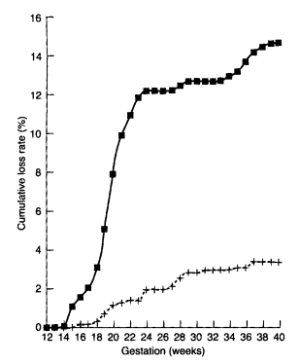
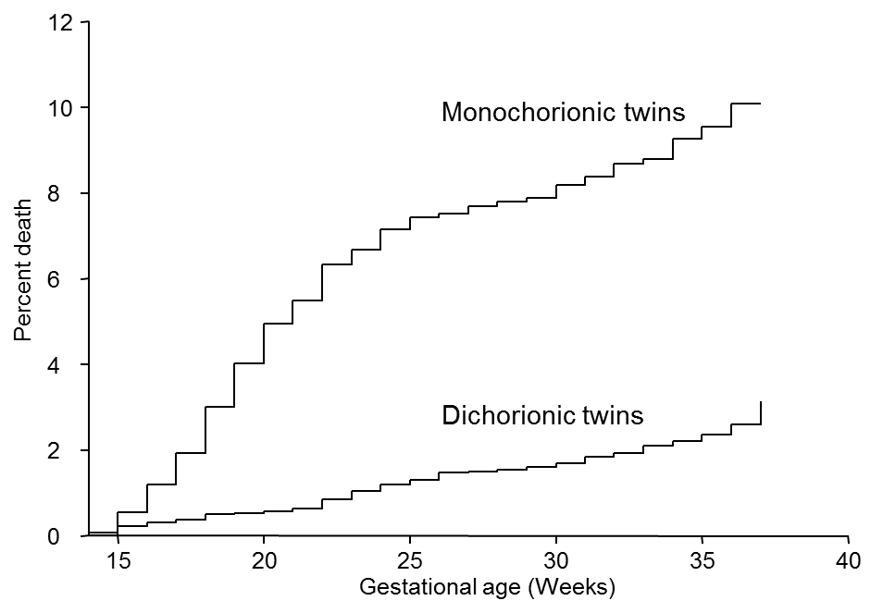
Diagnosis and management of multiple pregnancy
Cumulative perinatal loss rate in twins: early and Current evidence
Monochorionic
Monochorionic
Cumulative loss rate (%)
Dichorionic
Dichorionic
Gestation (weeks)
Dias et al 2013

Slide 16
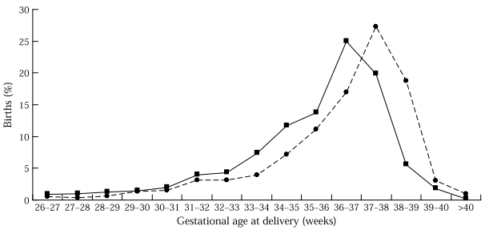
Diagnosis and management of multiple pregnancy
Timing of birth in twin pregnancy
Modal time of delivery
MC = 36–37 weeks
DC = 37–38 weeks
Birth (%)
Monochorionic
Dichorionic
Gestational age (weeks)
Dias et al 2012

Slide 17
Diagnosis and management of multiple pregnancy
Method Of Delivery
Vertex- Vertex (50%)
Vaginal delivery, interval between twins not to exceed 30 minutes.
Vertex- Breech (20%)
Vaginal delivery by senior obstetrician
Breech- Vertex( 20%)
Safer to deliver by CS to avoid the rare interlocking twins( 1:1000 twins ).
Breech-Breech( 10%)
Usually by CS.

Slide 18
Potential maternal and fetal complications associated with multiple pregnancy
Twin pregnancies are at increased risk of
Discordant anomaly
Aneuploidy
Growth restriction
Increased risk of miscarriage
Increased risk of preterm labour
Increased risk of stilbirths

Slide 19
Potential maternal and fetal complications associated with multiple pregnancy
MC
Feto-fetal transfusion syndrome
About 20–25% of twin pregnancies are monochorionic
Up to about 10–15% of monochorionic twin pregnancies are complicated by twin to twin transfusion syndrome (TTTS) due to abnormal placental vascular anastomosis
Another 8-12% of MC twins can be complicated with selective fetal growth restriction (sFGR) due to unequal placental sharing
TRAP -Twin reversed arterial perfusion
Conjoint twins

Slide 20
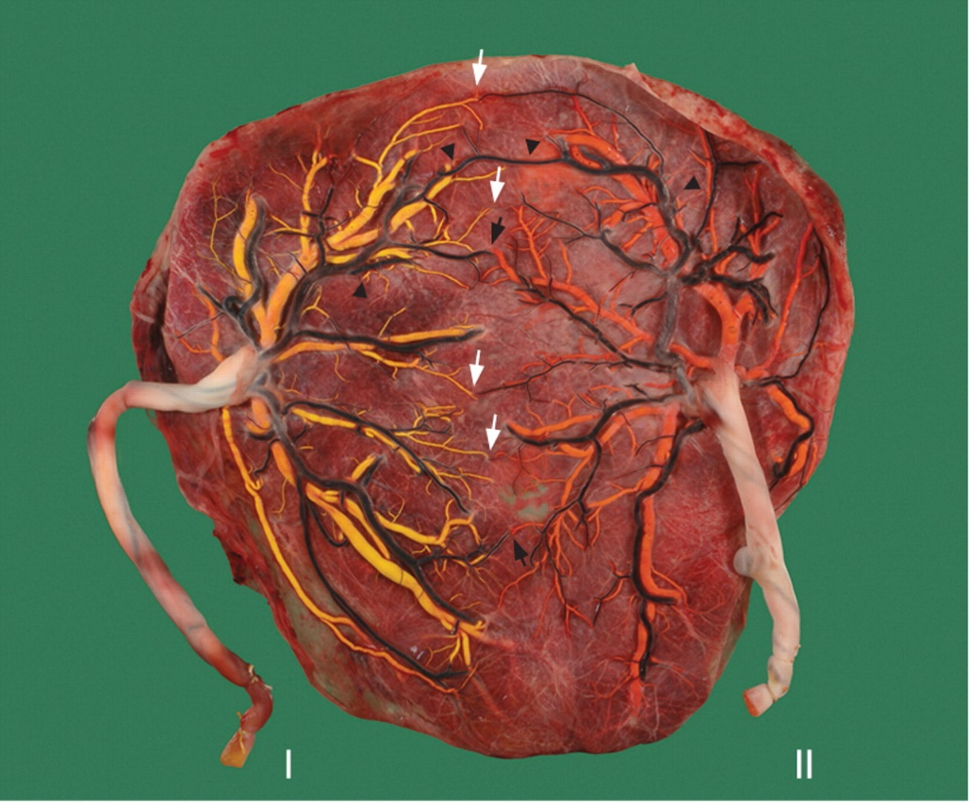
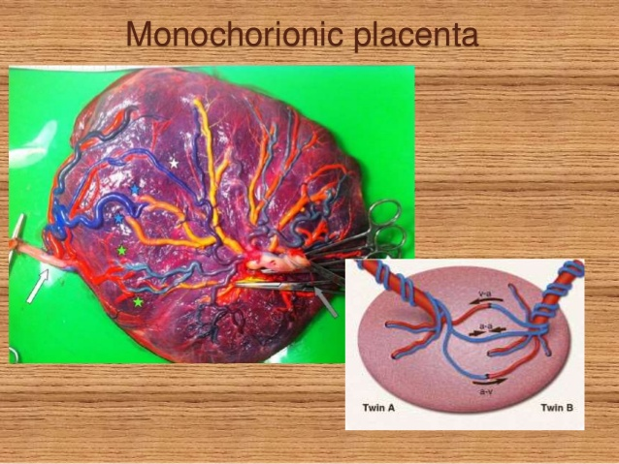
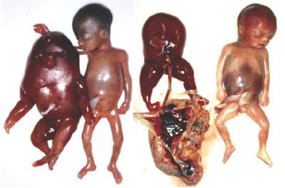
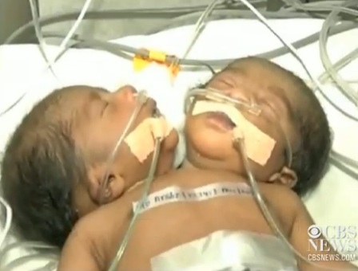
Potential maternal and fetal complications associated with multiple pregnancy

Slide 21
Potential maternal and fetal complications associated with multiple pregnancy
Monitoring for feto-fetal transfusion syndrome
staging
A
B
A
B
A
B
Twins A and B each have their own amniotic cavity, but a single placenta. Blood can flow from twin A to twin B, or vice-versa: there is balanced transfusion.
Twin A (donor) is transfusing twin B (recipient), without counterbalanced transfusion from B to A.
Twin A remains smaller, develops less amniotic fluid (becomes the 'stuck' twin). Twin B develops hydrops (swelling) and large amounts of amniotic fluid (polyhydramnios).

Slide 22
Potential maternal and fetal complications associated with multiple pregnancy
Monitoring for feto-fetal transfusion syndrome
staging
A staging system proposed by fetal surgeon Quintero is commonly used to classify the severity of TTTS
 | AFI Discrepancy | Presence of Bladder in donor | Abnormal Doppler studies | Fetal Hydrops | Fetal Demise
Stage 1
Stage 2
Stage 3
Stage 4
Stage 5

Slide 23
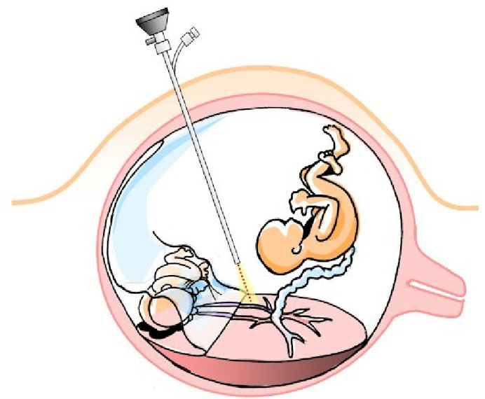
Potential maternal and fetal complications associated with multiple pregnancy
Treatment

Slide 24
Potential maternal and fetal complications associated with multiple pregnancy
Monitoring for intrauterine growth restriction
Growth discordance (L-S/L x 100) >25% in size between twins or triplets as a clinically important indicator of intrauterine growth restriction and offer referral to a tertiary level care

Slide 25
Maternal Complications
Potential maternal and fetal complications associated with multiple pregnancy
Women with twin pregnancies have a two to three times higher risk of developing hypertension during pregnancy than women with singleton pregnancies

Slide 26
Potential maternal and fetal complications associated with multiple pregnancy
Maternal complications
Hypertension
Advise women with twin and triplet pregnancies that they should take 75 mg of Aspirin daily from 12 weeks until the birth of the babies if they have one or more of the following risk factors for hypertension:
first pregnancy
age 40 years or older
pregnancy interval of more than 10 years
BMI of 35 kg/m2 or more at first visit
family history of pre-eclampsia

Slide 27
Potential maternal and fetal complications associated with multiple pregnancy
Preterm birth
More than 50% of twins and almost all triplets are born before 37 weeks of gestation
In Twins
Bed rest (at home or in hospital)
Progesterone (intramuscular or vaginal administration)
Cervical circlage
Tocolytics (oral betamimetics)

Slide 28
Summary
Importance of first scan- dating, chorionicity etc..
Importance of follow-up in MCDA for TTTS
Growth follow-up
Timing of delivery
Mode of delivery
Specific complications of MC
Maternal complications of multiple pregnancy

